Slide 1
Handshake Training
Presented by EWU Human Resources

Slide 2
Student Employment
Meet Our Team
Location: The Student Employment office is located in Showalter Hall Room 300.
Phone: 509.359.2525
Fax: 509.359.6262
Email: stuemploy@ewu.edu
Office Hours:
Mon - Fri: 8:00am - 5:00pm
Website: https://inside.ewu.edu/student-employment/

Slide 3
Handshake
Handshake is an online recruiting platform for EWU student employee jobs
All EWU student job postings must be posted in Handshake
EWU has standardized job descriptions. All student employee position postings must use one of those descriptions which can be located on the Student Employment website: https://inside.ewu.edu/student-employment/job-descriptions/

Slide 4
Creating an Account
For supervisors to access Handshake, they must create an “employer” account: https://ewu.joinhandshake.com/register?user_type=Employers&employer_invite_token=oKC9gzFwIkk8KeBBqvYQQbdZdjGu3uOB
If you have a student Handshake account at Eastern, please to reach out to Student Employment to get it switched to an employer account
Notes:
Some updates being made

Slide 5
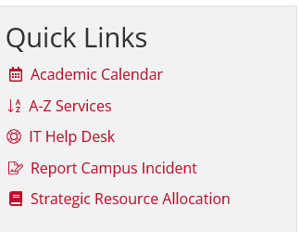
How to Find Handshake Link
You can access Handshake from InsideEWU Quick Links
Click on A-Z
Click on Handshake
Complete Single Sign On

Slide 6
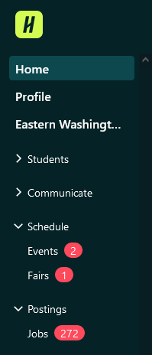
Establishing Job Posting
Once in account, click on Jobs:

Slide 7
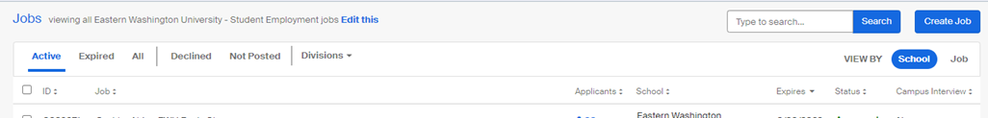
Posting a Job
Then, from your employer account, click “Create Job” on the top right on the page
All student jobs must be posted for a minimum of 48 hours
Notes:
Some updates being made

Slide 8
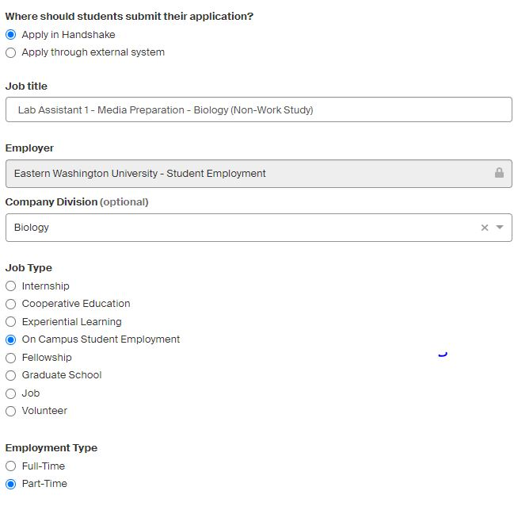
Posting a Job
On the Basics Page you must provide the following:

Slide 9
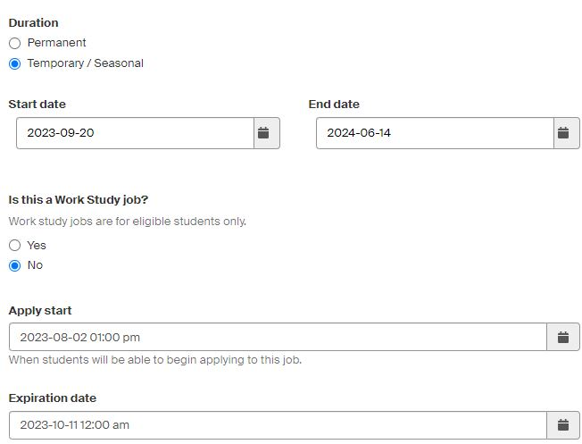
Position Term and WorkStudy
Basics Page continued:

Slide 10
Accessing Standardized Job Descriptions
Select from one of the standardized job descriptions. You may add a short opening to the description to promote the position and provide additional details. You can access the position descriptions here: https://inside.ewu.edu/student-employment/job-descriptions/
Note: EWU Student Employment opportunities are on campus, part-time (19 hours per week during classes), and temporary!

Slide 11

Posting a job continued
Now you will complete the “Details” tab:

Slide 12
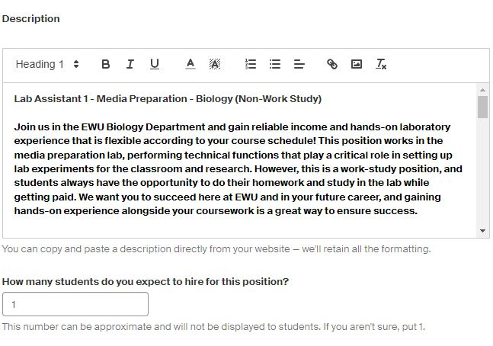
Job Description
Details page continued
The details tab is where you will add your standardized job description
You may add a short paragraph above the job description in order to “sell” your job or give additional details.

Slide 13
Options for Intro Paragraph
If you wish to add some department or college specific language to the posting, you can add a short opening statement above the standard job description in Handshake. For example,
In the Kingston Math Lab, students from various math classes come to work and study. It is the job of tutors to answer questions. During winter quarter, we will offer both in-person and online hours. Tutors are expected to keep a consistent schedule but can choose the number of hours they will work per week.

Slide 14
Salary
Make sure the salary matches the range specified in the job description. The following link provides the current salary ranges and accompanying pay scales
https://in.ewu.edu/student-employment/wp-content/uploads/sites/45/2023/01/2023-Student-Employee-Salary-Ranges.docx
When posting a job on Handshake, there is an option to include a salary range, please select “Custom Range” and add the salary range for the specific job in both boxes. The numbers will match (e.g. $15.74 - $15.74)

Slide 15
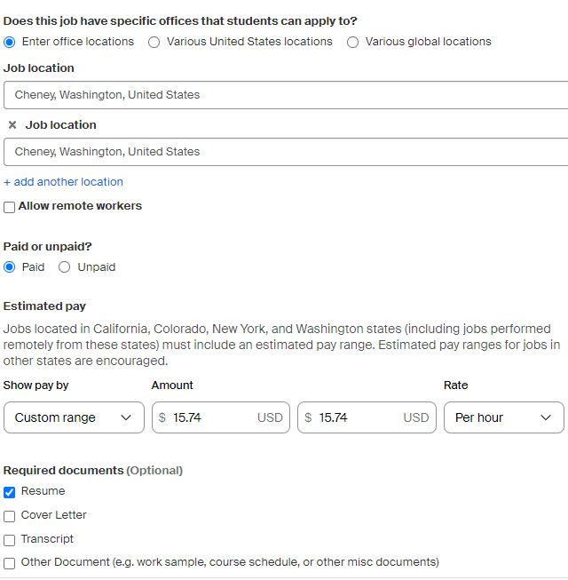
Job Location, Salary, and
Application Materials
Details page continued:

Slide 16
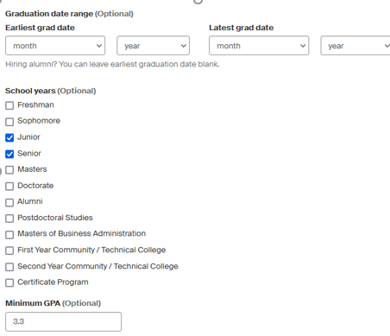
Preferences Tab
Please note: checking excessive filters will limit the number of applicant submittals. We encourage you to filter only as required for the requirements of the position.

Slide 17
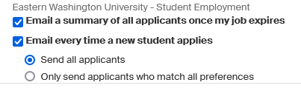
Additional Recommendations on Preference Tabs
While you can opt to only have the applications sent to you as a batch once the job posting expires, we do not recommend this approach as students will find other jobs if they do not hear back from you shortly after submitting applications.

Slide 18
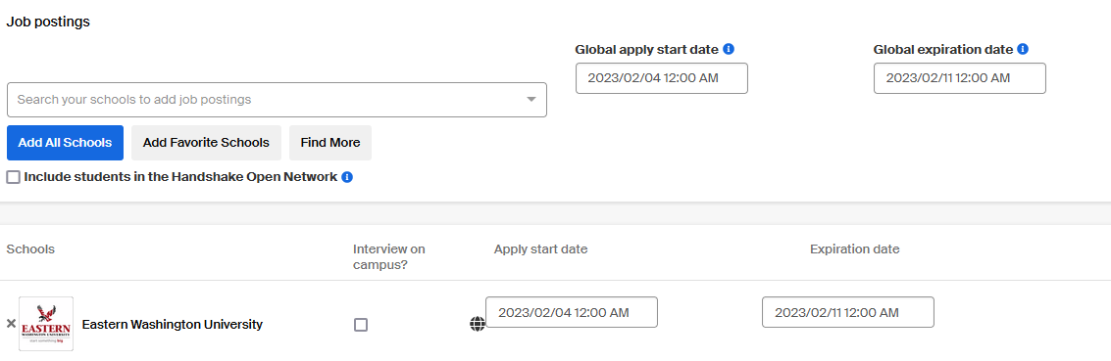
School and Job Dates
Under the schools’ tab, find Eastern Washington University, set an apply start and end date (always add an end date), and specify whether or not you would like to conduct interviews on for off campus.

Slide 19
Final Posting Tips
Review your posting to confirm it is accurate and submit.
Send an email to stuemploy@ewu.edu providing written evidence of approval from hiring authority e.g. Dean, AVP, Director to hire.
Student Employment will review your posting, confirm hiring approval, and reach out with any questions!

Slide 20
Handshake Tips
If posting a work study position and a non-work study position, you can duplicate the position.
Use your department name not college.
Use the salary range identified in the position description.
Check the temporary employment box.

Slide 21
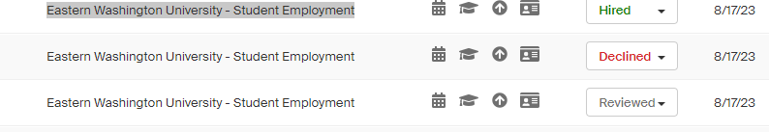
Selection of Employee and Notification to Applicants
After you make your hiring decision(s), update applicants’ status in Handshake to “Reviewed”, “Hired”, or “Declined”, as appropriate.
Insert screen shot

Slide 22
Notification to Applicants
Demonstrate professionalism and contact applicants who you did not choose to hire that you appreciate their interest, but they were not selected for the position.
If you interviewed them, please call them. If you didn’t interview them, you can email them.

Slide 23
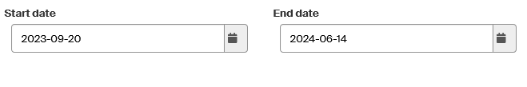
Close Posting in Handshake
If you make a hire before the original posting closes, please go into Handshake and modify the position end date so it shows the position as closed. This avoids students unnecessarily completing applications for a close position.

Slide 24

Happy Hiring!

