Slide 1

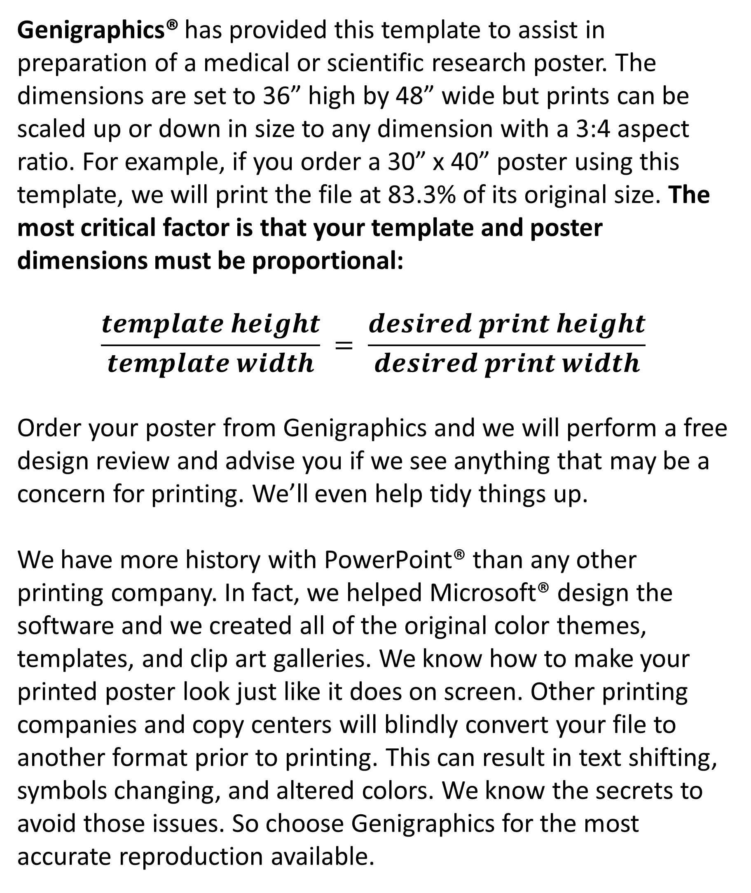
What Do Consumers In The Spokane & Metropolitan Area Prioritize More: Pricing Or Quality Of A Product?
Christopher Nava, UD¹; Habib Islam, PhD²
^{EASTERN WASHINGTON UNIVERSITY}, ^{SCHOOL OF BUSINESS}
ABSTRACT
INTRODUCTION
RESULTS
DISCUSSION
Businesses want to make as much money as possible, while consumers want to spend the least amount of money possible. The consumer can never have the best quality of a product for free. This study aims to examine whether the established trends in consumer behavior regarding pricing versus quality preferences apply to the Spokane and metropolitan area. Spokane and the metropolitan area will be divided into various regions to capture a diverse range of location, age, gender, and household income. Participants will be surveyed with questions about their shopping preferences for distinct categories of pricing preference, quality preference, brand and factors influencing their decisions. Data collected will be analyzed to find trends and patterns in consumer preferences, offering valuable insights into the trade-offs between shopping preferences, price, quality, and influence factors. The findings of this research will contribute to a better understanding of consumer behavior in the Spokane area, potentially guiding retailers and marketers in their strategic decision-making processes and helping them tailor their offerings to meet consumer demands effectively.
Genigraphics® has provided this template to assist in preparation of a medical or scientific research poster. The dimensions are set to 36” high by 48” wide but prints can be scaled up or down in size to any dimension with a 3:4 aspect ratio. For example, if you order a 30” x 40” poster using this template, we will print the file at 83.3% of its original size. The most critical factor is that your template and poster dimensions must be proportional:
$$\frac{template height}{template width} = \frac{desired print height}{desired print width}$$
Order your poster from Genigraphics and we will perform a free design review and advise you if we see anything that may be a concern for printing. We’ll even help tidy things up.
We have more history with PowerPoint® than any other printing company. In fact, we helped Microsoft® design the software and we created all of the original color themes, templates, and clip art galleries. We know how to make your printed poster look just like it does on screen. Other printing companies and copy centers will blindly convert your file to another format prior to printing. This can result in text shifting, symbols changing, and altered colors. We know the secrets to avoid those issues. So choose Genigraphics for the most accurate reproduction available.
Click here to insert your Results text. Type it in or copy and paste from your Word document or other source.
This text box will automatically re-size to your text. To turn off that feature, right click inside this box and go to Format Shape, Text Box, Autofit, and select the “Do Not Autofit” radio button.
To change the font style of this text box: Click on the border once to highlight the entire text box, then select a different font or font size that suits you. This text is Calibri 32pt and is easily read up to 4 feet away on a 36x48 poster.
Zoom out to 100% to preview what this will look like on your printed poster.
Speaking of Results, yours will look better if you remember to run a spell-check on your poster! After you’ve added your content click on Review, Spelling, or press F7.
Click here to insert your Discussion text. Type it in or copy and paste from your Word document or other source.
This text box will automatically re-size to your text. To turn off that feature, right click inside this box and go to Format Shape, Text Box, Autofit, and select the “Do Not Autofit” radio button.
To change the font style of this text box: Click on the border once to highlight the entire text box, then select a different font or font size that suits you. This text is Calibri 32pt and is easily read up to 4 feet away on a 36x48 poster.
To change the background color of any text box, click once on the box so it is outlined with a dashed border. Then select Shape Fill from the Drawing Tools, Format tab on the ribbon bar above. It’s the one with the ‘paint can’ icon.
Table 1. Label in 20pt Calibri.
CONCLUSIONS
 | Heading | Heading | Heading
Item | 800 | 790 | 4001
Item | 356 | 856 | 290
Item | 228 | 134 | 238
Item | 954 | 875 | 976
Item | 324 | 325 | 301
Item | 199 | 137 | 186
Click here to insert your Conclusions text. Type it in or copy and paste from your Word document or other source.
This text box will automatically re-size to your text. To turn off that feature, right click inside this box and go to Format Shape, Text Box, Autofit, and select the “Do Not Autofit” radio button.
METHODS AND MATERIALS
REFERENCES
Participants:
- 18 & older consumers from West Plains, Spokane, Spokane Valley, & Liberty Lake.
- Minimum of 30 participants from each region giving a total of 120.
Survey:
- Series of questions across various product categories, such as hygiene, entertainment, transportation, groceries, and clothing.
Qualitative:
- Find common themes and patterns, which will be categorized and presented as key factors influencing consumer decisions.
Click here to insert your References. Type it in or copy and paste from your Word document or other source.
Click on the border once to highlight and select a different font or font size that suits you. This text is in Calibri 24pt and is easily readable up to 3 feet away.
CONTACT
Christopher Nava
Eastern Washington University
Email: cnava4@ewu.edu
Chart 1. Label in 20pt Calibri.

