Slide 1
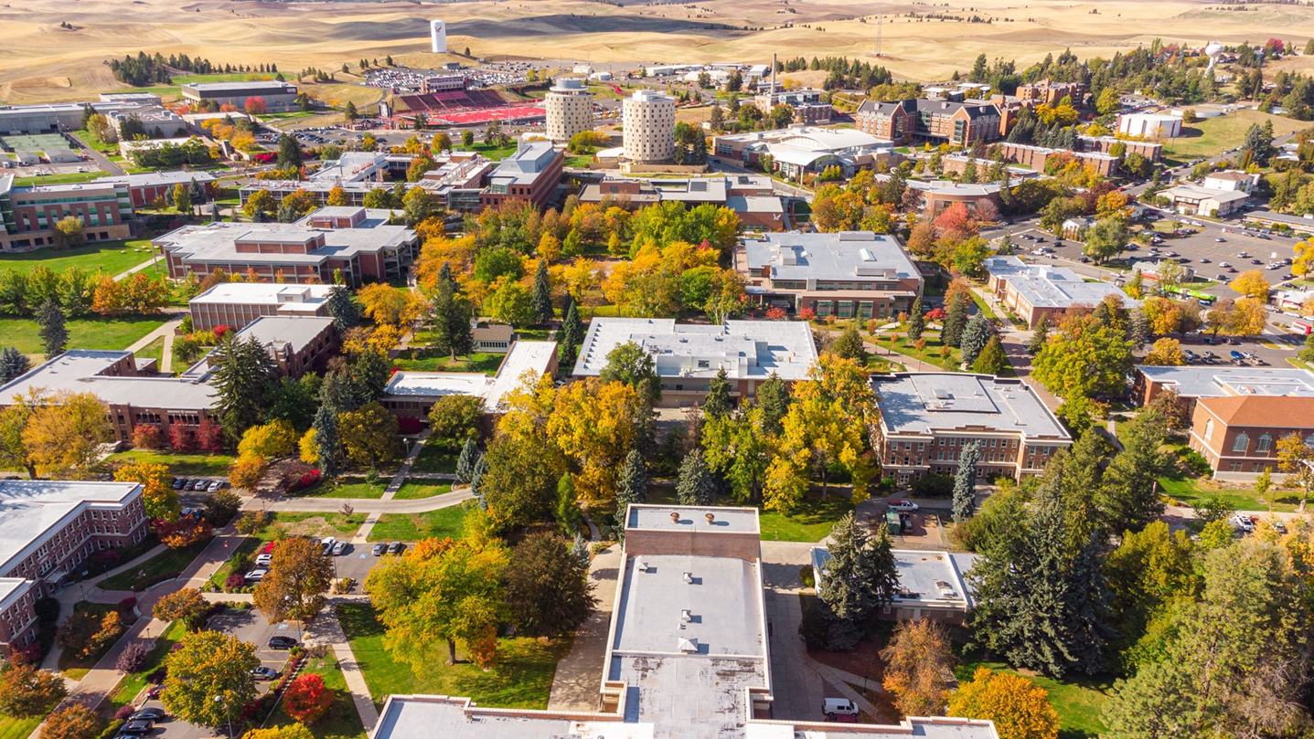
Affirmative Action & Supplier Diversity Annual Report to Board of Trustees- May 2022
Presented by Annika Scharosch, Assoc. Vice President

Slide 2

Strategic Plan Goal
Embrace Equity & Social Justice

Slide 3
Outline
Supplier diversity
Annual affirmative action data report

Slide 4

Supplier Diversity
Purchasing & public works

Slide 5

State of Washington
2019 Disparity Study
External firm retained by the State of Washington to determine the level of disparity in the participation of minority, women, and veteran owned businesses in state contracting and to provide recommendations
Reviewed $3.48 billion in spending by the State of Washington in FY 2012-2016

Slide 6
State Policy Findings
Most M/WBEs reported it is extremely difficult to obtain work on state projects
OWMBE certification conferred few benefits
Impact of Initiative 200
Difficult to access contracting information
Contracts were often too large for small firms
Insurance, bonding, experience requirements, etc. are barriers
Antiquated & decentralized state systems are challenging

Slide 7
Sample of Recommendations
Increase outreach to targeted industries
Review contract sizes & scopes
Provide technical assistance & supportive services to M/WBEs
Lengthen solicitation times
Review minimum requirements

Slide 8
EWU Implementation of Recommendations (In Progress)
EWU implemented a B2GNow data collection system for public works contracts
Bids are posted on the state’s vendor registration system
Outreach & technical assistance provided to M/WBEs
Engage with the Multi-Ethnic Business Association to help identify additional areas for improvement

Slide 9
Total Spend vs. OMWBE Certified
OMWBE numbers exclude a number of types of purchases including:
  Procurement card (approx. $4- 5 million/year)
  DES master contract purchases
  Purchases with MWBEs that are not certified by OMWBE
  Rentals, leases, utilities, travel, client services, library resources

Slide 10
OMWBE Certified Spend Trends- EWU
FY 2018: 2.63%
FY 2019: 2.01%
FY 2020: 0.91%
FY 2021: 5.26%
  Total spend was $41.64 million in public works and procurement

Slide 11
OMWBE Certified Spending: FY 2021
 | EWU | CWU | WWU | UW | WSU
Minority Owned | 5.24% | 0.40% | 2.18% | 0.30% | 0.03%
Women Owned | 0.02% | -- | 0.69% | 0.25% | 0.12%
M/W Owned | -- | 0.01% | 0.09% | 0.12% | 1.49%
Combination Business | 0.00% | -- | -- | 0.00% | --
Total | 5.26% | 0.41% | 2.96% | 0.67% | 1.65%

Slide 12
Purchasing Card Diversity Spending
Total purchasing card expenditures in FY 21: $3.6 million
10% of spending was with minority, women, veteran-owned, and socially/economically disadvantaged businesses

Slide 13
FY 23 Supplier Diversity Plan
Work to identify, contact, and assist local area businesses offering services and goods relevant to EWU and encourage them to become certified through OMWBE.
Have current and new vendors fill out a “Vendor Profile” form to help identify business classifications. EWU may be doing business with MWVO entities and not know it.
Attend local business trade shows to provide information about how to do business with EWU and become OWMBE certified.
Provide messaging and training to departments about the importance of and how to procure with MWVO/SED businesses.

Slide 14

Affirmative action data

Slide 15
Affirmative Action Data Collection
Affirmative action plans are required for federal contractors. The federal Office of Federal Contract Compliance Programs sets the rules.
Human Resources gathers data throughout the year about applicants and new hires
Snapshot taken of all applicants in 2021 and all persons employed as of December 31st
Data is used to develop a plan for 2022
Summary of the plan is presented to the Board of Trustees in May
Plan is used to set goals for individual recruitments throughout the year

Slide 16
Employee Demographic Form
Ethnic Group:
  Hispanic/Latino or not
Race: what race(s) or culture(s) do you consider yourself?
  American Indian/Alaskan Native
  Asian
  Black/African-American
  Hispanic
  Native Hawaiian or Other Pacific Islander
  White
  Two or more races
Are you a military veteran eligible for veteran’s preference?
Do you have a disability?

Slide 17
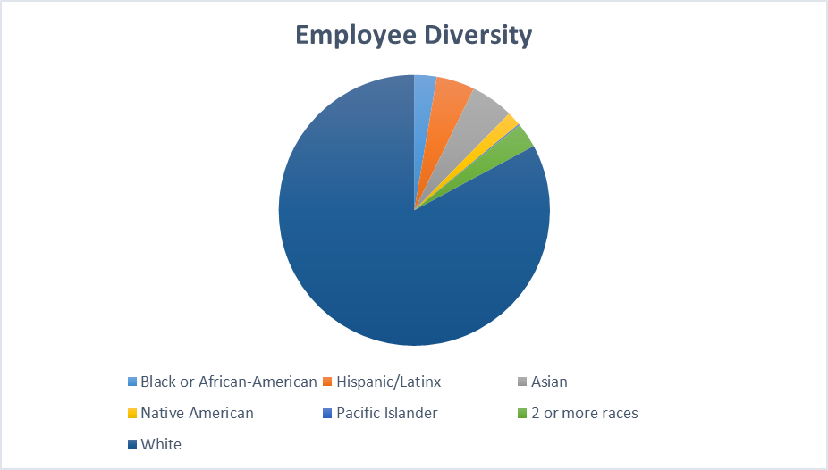

Slide 18
Employee Diversity- Race & Ethnicity- 2022
Total Employees: 1313
% who identified as underrepresented: 17.1%
  Black/African-American: 2.7%
  Hispanic: 4.6%
  Asian: 5.1%
  American Indian/Alaskan Native: 1.7%
  Pacific Islander: 0.2%
  Two or more races: 3.0%

Slide 19
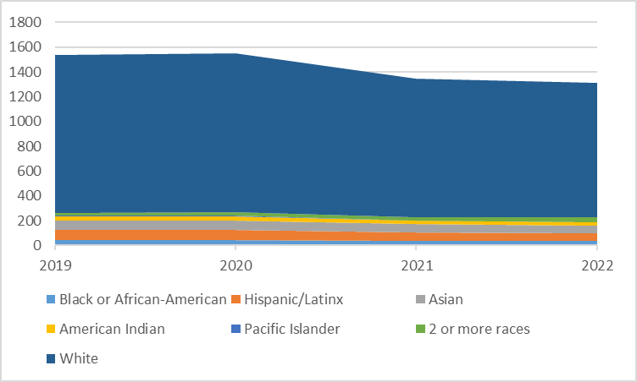
Employee Diversity- Workforce Trends

Slide 20
Employee Diversity- Workforce Trends
Year | Total % who identified as an underrepresented race/ethnicity | Workforce size
2019 | 16.9% | 1,539
2020 | 17.5% | 1,550
2021 | 16.9% | 1,343
2022 | 17.1% | 1,313

Slide 21
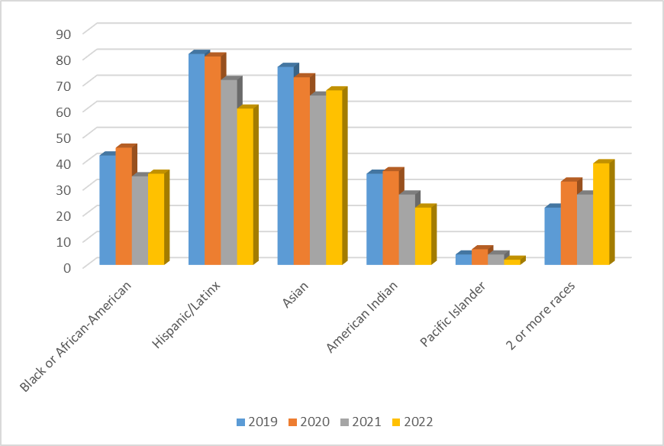
Employee Diversity- Workforce Trends

Slide 22
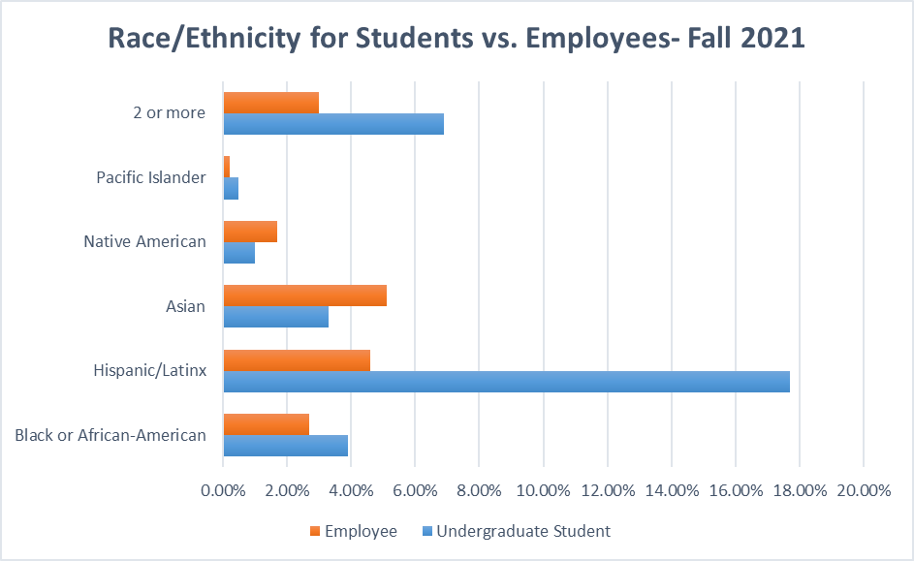
Employees vs. Undergraduate Students

Slide 23

Affirmative Action- Persons with Disabilities
Benchmark set by the federal government: 7.0%
EWU’s overall incumbency rate: 1.2%

Slide 24

Affirmative Action- Protected Veterans
Benchmark set by the federal government: 5.6%
Hiring rate in 2021: 5.2%

Slide 25
Comparisons with Available Workforce
“An affirmative action program is a management tool designed to ensure equal employment opportunity. A central premise underlying affirmative action is that, absent discrimination, over time a contractor’s workforce, generally, will reflect the gender, racial and ethnic profile of the labor pools from which the contractor recruits and selects.” 41 C.F.R. § 60-2.10(a)(1).

Slide 26
Affirmative Action- Gender & Minorities
Each institution sets its own goal based on available labor market
  EWU’s goal is 80% of the available relevant labor market
Each employee group has its own unique goal
  27 different groups; categories are based off of IPEDS reporting

Slide 27
Affirmative Action- Quantitative Analysis
Incumbency= people employed as of 12/31
Availability
  What is the availability of racially and ethnically diverse applicants in the relevant market?
    Faculty: nationwide (includes quarterly, lecturer, and tenure-track)
    Exempt: Washington State
    Classified: Inland Northwest

Slide 28
Diversity in the Classroom
Nation-wide availability of underrepresented faculty members= 29%*
Faculty incumbency by college:
  Professional Programs: 26.3%
  STEM: 19.0%
  Arts, Humanities & Social Sciences: 17.2%
  Health Sciences & Public Health: 1.9%
  Quarterly faculty from all colleges: 16.8%
  *Based on 2020 census data. Availability in prior years was 25.2% based on 2010 census data.

Slide 29

Groups Meeting or Exceeding
Affirmative Action Goals
Office and Administrative Support- Classified
Construction and Maintenance- Classified
Transportation, Moving & Mail- Classified
Computer, Engineering & Science Occupations- Classified
Community, Design, Sports & Media- Classified & Exempt
College of Professional Programs- Faculty
Residential life, admissions, CAAR, other instructional support- Exempt
Note: this is for the collective employment of all underrepresented races and ethnicities, not specific identifies. Employee groups of less than 10 employees are also excluded.

Slide 30
Areas for Significant Growth
Areas where 5+ underrepresented employees need to be hired before EWU will meet its affirmative action goals:
  Service Occupations- Classified
  CAHSS- Faculty
  CSTEM- Faculty
  CHSPH- Faculty
  Quarterly faculty

Slide 31
Voluntary Departures
Areas where there was an overall decrease of 5+ racially and ethnically underrepresented employees:
  Service Occupations- Classified
  Management Occupations- Exempt
  Community, Design, Sports & Media- Exempt
  Residential life, CAAR, other instructional support- Exempt

Slide 32
More Workforce Information
https://inside.ewu.edu/hr/hr-services/#metrics

