Slide 1
Eastern Washington University
Steering Committee Meeting
  August 23, 2024
Notes:
Use for computer-screen presentations.

Slide 2

  Budget Model Overview
  Case STudies
  Metrics Discussion

Slide 3

Budget Model Overview

Slide 4
Modeling Option 3
Performance-Based/Activity-Based/Incentive-Based Hybrid
Funding Source
Allocation Mechanism
Recipient
Undesignated fees
Performance measures
Academic college
State operating
Strategic initiatives
Support services
Student credit hours rolling three-year avg
Tuition revenue
Internal services
Indirect cost allocation
Designated fees
Designated unit
IDC contribution
Capital
IDC contribution
Capital
Grants and contracts
IDC contribution
Designated unit
Auxiliaries
IDC contribution
Auxiliaries

Slide 5
Direct Funding Mechanisms
Capital
State capital funding
Certificate of participation
Grants & Contracts
Restricted grants and contracts with federal, state, and local agencies or private organizations
Auxiliaries
Designed to generate sufficient revenue to cover the cost of operating and capital needs
Designated Fees
In development
Typically, fees that are required by a third party to be designated for a purpose
Debt service
Revenue bond commitments

Slide 6
Combined Revenue Pool
Tuition
Undesignated Fees
State Operating
Combined Revenue Pool

Slide 7
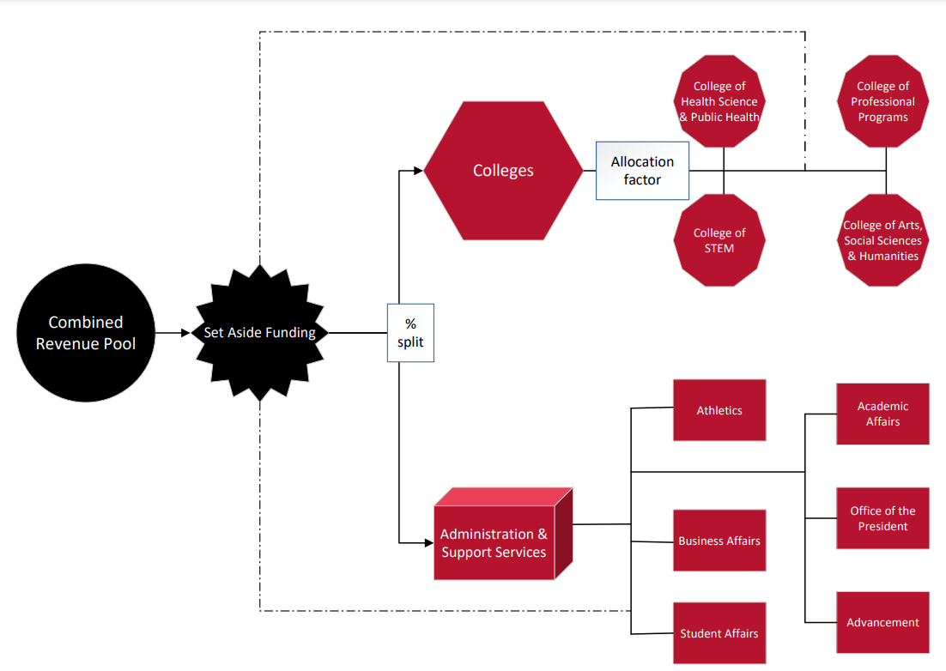
Combined Revenue Pool Allocation Overview

Slide 8
Key Decision Points
Set Aside Funding levels for strategic initiatives, subvention, incentives, and performance
Determination of strategic initiatives, incentives, and performance measures
Percentage split between administration and colleges
Allocation factor(s) among colleges
Funding mechanisms and allocation factor(s) for administration and support services

Slide 9

Case Study: PennState
“The model dynamically connects the activity of a specific unit—such as student headcount, student credit hours, and research expenditures—to their base budget allocation. The budget model has intentionally incorporated strategic funds to provide additional support for some units with activities and contributions that cannot be fully captured in those metrics. This funding aligns with feedback from deans, chancellors, administrative leaders, and financial officers during the development phase.”

Slide 10
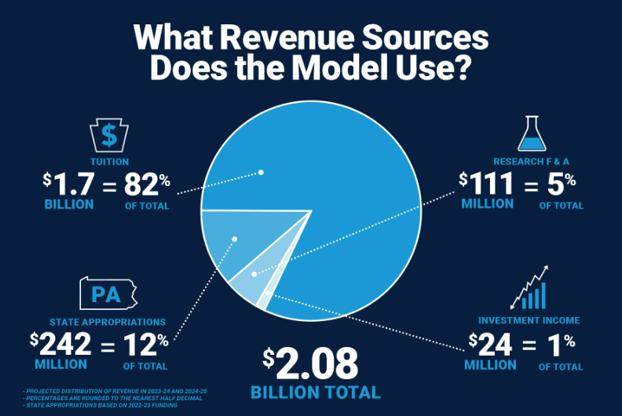
PennState Revenue Sources

Slide 11
PennState Budget Process
Establish E&G Total Revenue
Set aside funds for strategic and mission-critical needs
Calculate units’ initial budget allocations
Fund student-support and administrative units
Calculate college and campus formula-based budget allocation
Allocate strategic funds to units and priority initiatives

Slide 12
PennState Allocation Mechanisms
Colleges: Formula-based approach using 3 year average of student credit hours (65%), student headcount (35%)
Incentives: Non-resident tuition, research F&A dollars
Administration & Student Support Services: Past cost data and benchmarking with other institutions

Slide 13
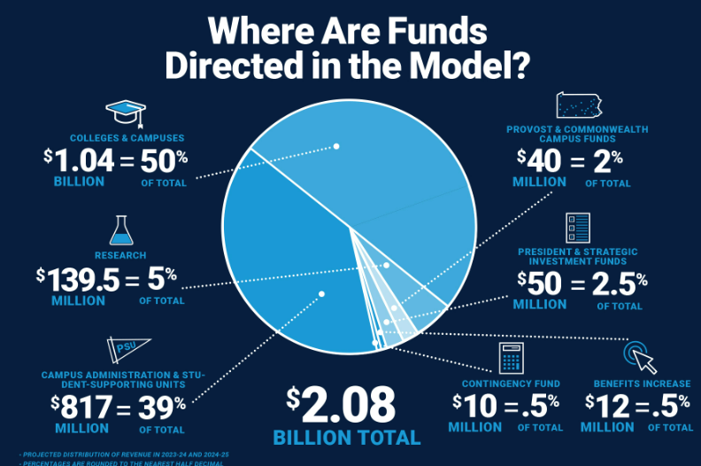
PennState Results

Slide 14

Case Study: University of North Dakota
“Much effort was made to acknowledge the complexity and diversity of UND, yet keep the model simple to allow for everyone to understand the flow of resources.
Revenue is tied to activity levels, such as student credit hours, grants awarded, ticket sales, etc. As these activity levels increase so does the revenue to the unit that is helping to generate the activity levels.”

Slide 15
Funds Flow Overview
Strategic Investment Pool: All units are charged a participation fee of 15.8%
Tuition revenue: Allocated based on student credit hour production (60% to the college of instruction, 40% to the college of record)
Program and course fees: Flow directly to the colleges and schools, exempt from participation fee
State appropriations: Allocated based on instruction (70%) and research (30%)
Research: Flow to the unit awarded the grant/contract, charged an indirect cost rate
Auxiliaries: Flow directly to the unit provided the service or product

Slide 16
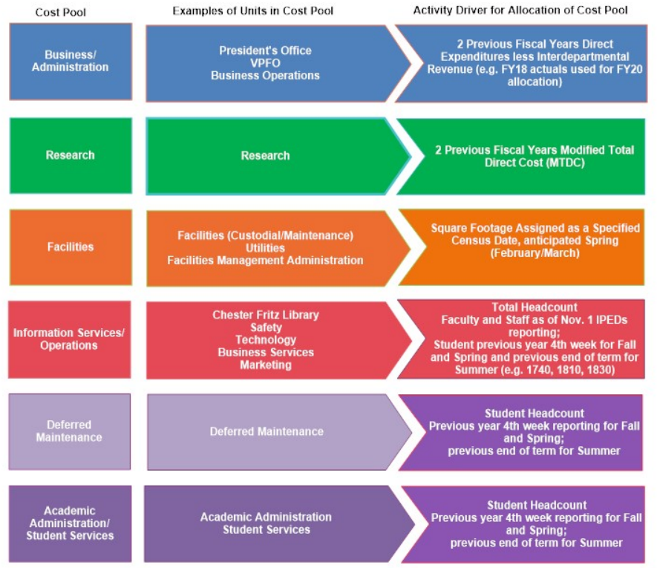
Funds Flow Overview
Service Unit Cost Pools:
Administrative Cost Pools

Slide 17
Case Study: University of Kansas
“Moving from a historical allocation model to a Priority Centered Management (PCM) model will allow the university to ensure sufficient reserves, invest in priorities, and better support decentralized program innovation geared toward advances in strategic priorities for the university.
The model also uses different mechanisms to determine allocations, one for academic units and one for the support units. Academic units are most directly affected by the different formulas as a portion of their formula is tied to Student Credit Hours (SCH)…These units will also receive a portion of their revenue based on performance related to institutional strategic priorities.”

Slide 18
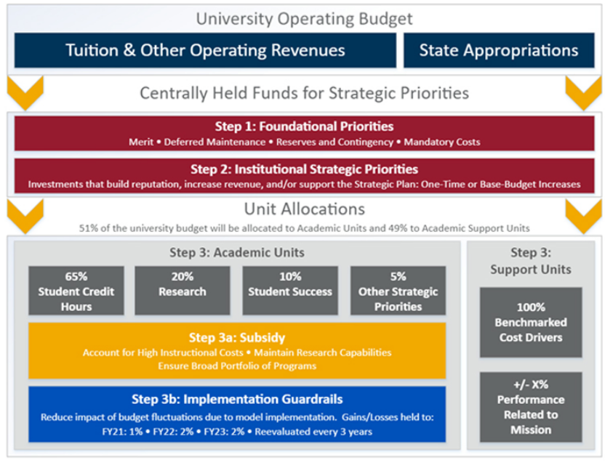
Budget Model Overview

Slide 19
Allocation Basis
“Initially, 51% of remaining funds will be allocated to academic units and 49% will be allocated to support units.”
Support Unit allocation:
Assigned to receive 100% of prior year budget until benchmarking can be calculated
Eligible for increases/decreases based on performance related to mission
College allocation:
65% student credit hours
20% research
10% student success
5% other priorities
Subsidies for high instructional cost or other strategic benefit

Slide 20

What are your key takeaways from the prior case studies?

Slide 21
Allocation Factors Among Colleges
Typical allocation factors:
Student credit hour production
Declared majors by college
Potential additional factors for consideration:
First time freshman graduation rates
Underserved student graduation rate
Transfer student graduation rate
Research

Slide 22
Allocation Factors Among Admin/Support Services
Finance
Average direct expenditures over last 3 FYs
Student Services
Average student headcount over last 3 FYs
Facilities
Square footage occupied
HR/IT
Employee headcount
FTE
Total headcount (staff & students)

Slide 23

What allocation metrics should EWU consider in its budget model?

Slide 24
Incentives
Factors to encourage specific activities through financial incentives
Examples of incentives:
      International students
      Online enrollment
      Certificate programs
      Increase class fill rates
      Student retention
      Research

Slide 25

What incentives should EWU consider in its budget model?

Slide 26

Project Status Check-In

Slide 27






Budget Revision Process
ADOPT
REVIEW
DEVELOP
DISCOVER
Produce policies, procedures, trainings, and guides to support EWU in adopting the revised budget model.
COORDINATE
Workshop the revised budget model with key EWU staff and stakeholders to promote transparency and change management.
In collaboration with EWU, develop a revised budget model that includes an expenditure allocation model based on service unit production, performance, and institutional strategy.
Conduct an environmental scan of EWU’s current budget processes through document review, financial analysis, interviews and focus groups with employees and leadership.
Develop a comprehensive project plan to address the scope of work, provide progress reports, and perform quality assurance.

Slide 28
Project Milestones
Project
Kickoff
Stakeholder Input
Interviews and Focus Groups
Current State Assessment
Summarize strengths, weaknesses, and opportunities
Draft
Budget model
Review Session
Review and iterate on draft budget model with Moss Adams team, gathering additional information as needed
Review Session
Review results of Discovery, and develop principles to guide budget model development
Stakeholder Input
Review draft model with Moss Adams to provide input and additional considerations for implementation
Discovery Facilitation
Data, documents, interview set-up
Finalize
Budget model
Execute
Carry out implementation of revised budget model
Implementation Support
Develop policies, procedures, guides, trainings
Moss Adams Deliverables
FEB-APR
EWU Steering Committee
EWU Staff & Stakeholders
MAY-OCT
NOV - JUNE

Slide 29

Next Steps
Moss Adams to continue workshopping budget model using EWU data
Upcoming Steering Committee work to focus on review of the draft budget model and identified decisions
Academic Affairs to provide input on performance measures for college allocations
Collaboratively continue to iterate upon the budget model

Slide 30
Notes:
NOTE: A version of the content disclaimer is available without the “Thank You” overlay if you prefer to show this at the beginning of your presentation,
-----
Presentation Builder path:
https://alliance.mossadams.com/proposalcentral/presentationbuilder/Forms/AllItems.aspx

